Slide 1



Review and Reclassification
Copyright © 2025. Texas Education Agency.

Slide 2
Copyright © Notice
Copyright © 2025. Texas Education Agency.
All Rights Reserved.
Notwithstanding the foregoing, the right to reproduce the copyrighted work is granted to Texas public school districts, Texas charter schools, and Texas education service centers for non-profit educational use within the state of Texas, and to residents of the state of Texas for their own personal, non-profit educational use, and provided further that no charge is made for such reproduced materials other than to cover the out-of-pocket cost of reproduction and distribution. No other rights, express or implied, are granted hereby.
For more information, please contact: copyrights@tea.texas.gov
Copyright © 2025. Texas Education Agency.
Notes:
Slide 2

Slide 3
Agenda
Introduction
Identification
Placement
Emergent Bilingual Student Services
Review and Reclassification
Monitoring and Evaluation
89 TAC §1220, 1226 (2025)
Copyright © 2025. Texas Education Agency.
Notes:
Slide 3

Slide 4
Section Objective
Content/Language Objective
We will be able to summarize the requirements for conducting ongoing and annual review of emergent bilingual student progress and criteria for reclassification of students as English proficient.
89 TAC §1220, 1226
Copyright © 2025. Texas Education Agency.
4
Notes:
Slide 4

Slide 5
Ongoing/Mid-Year Review
Bilingual Education
Bilingual Program Services
(Dual Language Immersion/ Transitional Bilingual)
ESL Program Services
(Content-Based/ Pull-out)
EB Student with Parent Denial
(no bilingual program services)
LPAC Responsibilities:
Monitors progress of language and academic proficiency
Ensures participation in TELPAS
Makes state assessment decisions
EB Student with Parent Denial
(no ESL program services)
Recommends for Reclassification*
*Reclassification will be recommended when EB students meet readiness.
Copyright © 2025. Texas Education Agency.
5
Notes:
Slide 5

Slide 6
Ongoing Monitoring
For emergent bilingual students participating in a program and those with a parental denial, the LPAC
monitors the progress of language and academic proficiency and
ensures participation in TELPAS (listening, speaking, reading, and writing) until reclassification as an English proficient student.
89 TAC §1226
Copyright © 2025. Texas Education Agency.
6
Notes:
Slide 6
The students’ teachers should be aware of which students have a parental denial of program services.
The LPAC should continue to communicate with the students’ parents or guardians throughout the school year, providing updates on the students’ progress.

Slide 7
State Assessments: LPAC Decision-Making
Close to the time of testing administration of the state criterion-referenced test (STAAR) each year, the language proficiency assessment committee shall
determine the appropriate assessment option for each emergent bilingual student.
make designated support decisions based on
    an individual student’s particular needs for second language acquisition support and
    whether the student routinely, independently, and effectively uses the designated support in instruction and classroom testing.
89 TAC §1226
Copyright © 2025. Texas Education Agency.
7
Notes:
Slide 7
LPACs are responsible for following administrative procedures in the guide, making decisions on an individual student basis, working as a committee to make decisions, and maintaining the required documentation.
LPACs must coordinate with subject-area teachers. Providing unfamiliar accommodations may hinder rather than help a student.
Designated support decisions should be made as close as possible to the assessment to account for the student’s progress in acquiring the English language.
Designated supports do not impede students from reclassification.
Please visit the LPAC Decision-Making Resources located at the following link:
https://tea.texas.gov/student-assessment/testing/student-assessment-overview/accommodation-resources/language-proficiency-assessment-committee-resources.

Slide 8
State Assessments: LPAC Decision-Making
LPACs must make and document assessment participation decisions in accordance with requirements for the Texas Assessment Program.
EB students, including students classified as emergent bilingual (EB)/English learner (EL) in the Public Education Information Management System (PEIMS) whose parents have declined bilingual or English as a second language (ESL) program services (PEIMS code C), are required to take STAAR, unless they meet the eligibility requirements for STAAR Spanish or STAAR Alternate 2.
A student's LPAC must determine if STAAR Spanish is the most appropriate assessment to measure his or her academic progress. A student’s admission, review and dismissal (ARD) committee must determine if the student meets the STAAR Alternate 2 participation requirements, which are available on the STAAR Alternate 2 Resources webpage.
LPAC Decision-Making – Student Assessment Division
Copyright © 2025. Texas Education Agency.
8
Notes:
Slide 7
LPACs are responsible for following administrative procedures in the guide, making decisions on an individual student basis, working as a committee to make decisions, and maintaining the required documentation.
LPACs must coordinate with subject-area teachers. Providing unfamiliar accommodations may hinder rather than help a student.
Designated support decisions should be made as close as possible to the assessment to account for the student’s progress in acquiring the English language.
LPACs may not recommend designated supports, special assessment considerations, or accountability provisions for an emergent bilingual whose parents or guardians have denied bilingual or ESL services. This includes no designated supports, no testing in Spanish, no English I special provision, and no unschooled asylee or refugee provisions.
Please visit the LPAC Decision-Making Resources located at the following link:
https://tea.texas.gov/student-assessment/testing/student-assessment-overview/accommodation-resources/language-proficiency-assessment-committee-resources.

Slide 9
State Assessments: LPAC Decision-Making
For all emergent bilingual students, the LPAC shall:
Make decisions that are applicable for all assessments administered in the current school year and may carry over decisions from spring to summer administrations.
Identify STAAR designated supports (for emergent bilingual students receiving services only), keeping in mind supports may not prevent the student from being considered for reclassification at the end of the year.
Document any changes in a student's situation that have occurred between administrations, especially if a student no longer requires designated supports.
LPAC Decision-Making – Student Assessment Division
Copyright © 2025. Texas Education Agency.
9
Notes:
Slide 8
Please visit the LPAC Decision-Making Resources located at the following link:
https://tea.texas.gov/student-assessment/testing/student-assessment-overview/accommodation-resources/language-proficiency-assessment-committee-resources
See the Emergent Bilingual Reclassification Criteria Chart for information on designated supports that prevent reclassification, located on the TEA Bilingual/ESL Programs webpage: https://tea.texas.gov/academics/special-student-populations/bilingual-esl-education.

Slide 10
State Assessments: LPAC Decision-Making
All EB students, including students with parent denial for program participation, shall be given linguistic supports as appropriate to ensure they are developing proficiency in the English language and mastering grade level content for each grade through their educational experience.
LPAC members shall
Monitor the academic progress of each student
Recommend linguistic accommodations for instruction and assessments during MOY
Determine if students meet reclassification criteria, and
Monitor students that have reclassified during year 1 and year 2
LPAC Decision-Making – Student Assessment Division
Copyright © 2025. Texas Education Agency.
10
Notes:
Slide 9
Please visit the LPAC Decision-Making Resources located at the following link:
https://tea.texas.gov/student-assessment/testing/student-assessment-overview/accommodation-resources/language-proficiency-assessment-committee-resources

Slide 11
TELPAS Participation
Texas English Language Proficiency Assessment System (TELPAS) and TELPAS Alternate:
  Fulfill federal requirements for annually assessing English language proficiency of EB students in K-12
  Assess language proficiency in listening, speaking, reading and writing
For TELPAS assessments, all emergent bilingual students are assessed, regardless of whether parents or guardians have denied bilingual education, bilingual or ESL programs.
For EB students receiving special education services, the LPAC works in conjunction with the admission, review, and dismissal (ARD) committee.
LPAC Decision-Making – Student Assessment Division
Copyright © 2025. Texas Education Agency.
11
Notes:
Slide 10
Please visit the LPAC Decision-Making Resources located at the following link:
https://tea.texas.gov/student-assessment/testing/student-assessment-overview/accommodation-resources/language-proficiency-assessment-committee-resources
LPACs are responsible for making and documenting TELPAS participation decisions.

Slide 12
LPAC Decision-Making for
Dually Identified Students
34 CFR §200.6(h)(5) requires that a State administer an alternate ELP assessment for emergent bilingual students with the most significant cognitive disabilities who cannot participate in the ELP assessment, even with appropriate accommodations.
Texas developed the TELPAS Alternate, a holistic inventory that assesses English language proficiency to
  satisfy the alternate ELP assessment requirement for students with the most significant cognitive disabilities AND
  reduce exemptions from specific language domains on TELPAS.
  TELPAS Alternate
Copyright © 2025. Texas Education Agency.
12
Notes:
Slide 11
Please visit the LPAC Decision-Making Resources located at the following link:
https://tea.texas.gov/student-assessment/testing/student-assessment-overview/accommodation-resources/language-proficiency-assessment-committee-resources

Slide 13
LPAC Decision-Making for
Dually Identified Students
19 TAC Chapter 101 of the TAC requires the LPAC to work in conjunction with the ARD Committee to make assessment decisions or emergent bilingual students who are also eligible for special education services.
This collaboration helps ensure that factors related to a student’s disability and second language acquisition are both carefully considered.
LPAC Decision-Making – Student Assessment Division
Copyright © 2025. Texas Education Agency.
13
Notes:
Slide 12
For more information please read the Guidance Related to ARD Committee and LPAC Collaboration located at the following link: https://tea.texas.gov/academics/special-student-populations/special-education/programs-and-services/state-guidance/guidance-related-to-ard-committee-and-lpac-collaboration

Slide 14
LPAC Decision-Making for
Dually Identified Students
The LPAC is responsible for making designated supports decisions for the STAAR program or other applicable committee, and TELPAS in conjunction with the student’s individualized education program (IEP), individual accommodation plan (IAP), or section 504 plan paperwork.
  Designated supports decisions related to the student’s particular needs for second language acquisition support.
  Designated supports decisions related to the student’s disability.
Educators making these decisions should become familiar with all information on the TEA Accommodation Resources webpage.
LPAC Decision-Making – Student Assessment Division
Copyright © 2025. Texas Education Agency.
14
Notes:
Slide 13
A student should be designated as eligible for a special paper administration of an online assessment only if a required accommodation documented in the student’s individualized education program (IEP), individual accommodation plan (IAP), or section 504 plan paperwork cannot be delivered in an online format. Careful consideration should be given to whether the paper mode offers the supports necessary to allow the student to successfully demonstrate his or her understanding of the assessed content. If the student has previous experience receiving instruction or taking assessments online (e.g., STAAR Interim Assessments), it may be more appropriate to maintain consistency by providing the student with an online administration.
For more information please visit the Accommodation Resources webpage:
https://tea.texas.gov/student-assessment/testing/student-assessment-overview/accommodation-resources

Slide 15
Accessibility Resources
Designated supports decisions for STAAR and TELPAS are to be made by LPACs in accordance with policies and procedures in the following:
    Decision-Making Guide for LPACs (PDF)
    https://tea.texas.gov/student-assessment/test-administration/lpac-educator-guide.pdf
    Accessibility Policy Documents located on TEA’s Accommodation Resources webpage
    https://tea.texas.gov/accommodations/
LPAC Decision-Making – Student Assessment Division
Copyright © 2025. Texas Education Agency.
15
Notes:
Slide 14

Slide 16
LPAC Annual Review
At the end of the year, the LPAC reviews every emergent bilingual student identified in PEIMS
  being served in a bilingual or ESL program;
  with a parental denial; and
  who has been reclassified as an English proficient student and is in his or her first (F) or second (S) year of monitoring.
  For each emergent bilingual student, the LPAC reviews the progress of academic and language proficiency, determines if reclassification criteria has been met, and notifies the parent or guardian of progress and reclassification/exit, or continuation of program services, as applicable.
Copyright © 2025. Texas Education Agency.
16
Notes:
Slide 15
The LPAC end-of-year review may include:
Benchmarks
Classroom Tests
State Criterion-Referenced Test Data
Norm-referenced English and Spanish (when applicable) Standardized Achievement Test Data
Oral Language/English Language Proficiency Test Data
TELPAS, Primary Reading Assessments, etc.
Passing grades in all subjects and courses taken
Any input that will give a well-rounded picture of the student’s growth and progress

Slide 17
Reclassification of Emergent
Bilingual Students
For exit from a bilingual education, bilingual or ESL programs, a student may be classified as English proficient only at the end of the school year in which a student would be able to participate in a general education, all English instructional program. This determination shall be based upon all of the following:
a composite proficiency rating, which includes ratings in the areas of listening, speaking, reading, and writing, on the state-approved English language proficiency test for reclassification that is designated for indicating English proficiency;
Copyright © 2025. Texas Education Agency.
17
Notes:
Slide 16

Slide 18
Reclassification of Emergent Bilingual Students
    passing standard met on the English language arts and reading assessment instrument under Texas Education Code (TEC), §39.023(a) or
(c), or, for students at grade levels not assessed by the aforementioned assessment instruments, a score at or above the 40th percentile on both the English reading and the English language arts sections of the state- approved norm-referenced standardized achievement instrument; and
3) the results of a subjective teacher evaluation using the state's
standardized rubric.
Copyright © 2025. Texas Education Agency.
18
Notes:
Slide 16

Slide 19
Reclassification of Emergent Bilingual Students
Subjective Teacher Evaluation
To meet ESSA Title III, Part A requirements as described in the Texas ESSA State Plan for a standardized, statewide exit criteria, the Emergent Bilingual Reclassification Rubric is utilized for the Subjective Teacher Evaluation portion of the reclassification criteria.
The Emergent Bilingual Reclassification Rubric-Alternate is utilized for emergent bilingual students with a significant cognitive disability to fulfill the Subjective Teacher Evaluation portion of the individualized reclassification criteria.
Copyright © 2025. Texas Education Agency.
19
Notes:
Slide 17
See the Emergent Bilingual Reclassification Rubric and Emergent Bilingual Reclassification Rubric – Alternate on the TEA Bilingual/ESL Programs webpage: https://tea.texas.gov/academics/special-student-populations/bilingual-esl-education.
These rubrics are NOT suggested forms. They are required forms that must be used without modification and must be retained in the student’s records.
Emergent Bilingual Reclassification Rubric - Subjective
Emergent Bilingual Reclassification Rubric - Alternate

Slide 20
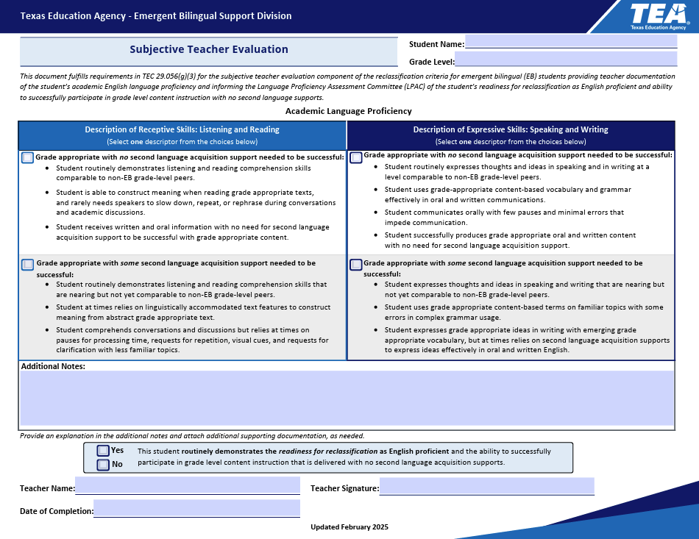
Emergent Bilingual Reclassification Rubric
Copyright © 2025. Texas Education Agency.
20
Notes:
Slide 18
This is NOT a suggested form. This is a required form that must be used, and not modified, and must be retained in the student’s records.

Slide 21
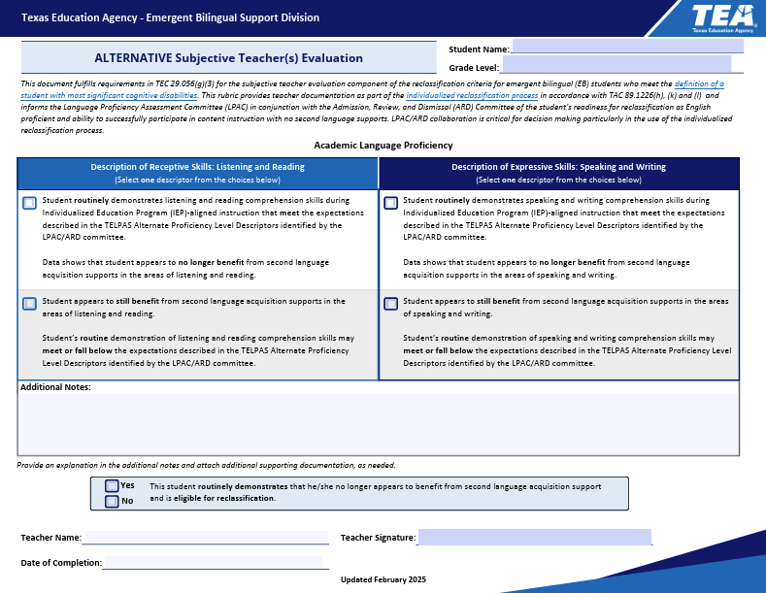
Emergent Bilingual Reclassification
Rubric - ALTERNATE
Copyright © 2025. Texas Education Agency.
21
Notes:
Slide 19

Slide 22
Decisions Pending Results
If STAAR results are not yet available when the LPAC meets at the end of the school year to make reclassification decisions, the LPAC will conduct the following process:
The LPAC makes the decision for reclassification, pending STAAR results, if the student has met all other reclassification criteria and if the LPAC determines that the student will be ready for reclassification if STAAR results demonstrate that the student has met standard (Approaches, Meets, or Masters levels).
The LPAC must have a follow-up process as soon as scores are received by the district to enact on the LPAC reclassification decisions pending STAAR results.
Once scores are received, a member of the LPAC will enter the scores into the LPAC documentation and complete the reclassification process for eligible students without the need for another LPAC meeting.
Copyright © 2025. Texas Education Agency.
22
Notes:
Slide 20
The school district shall give written notification to the student's parent or guardian of the student's reclassification as English proficient and his or her exit from the bilingual education or ESL program and acquire written approval as required under the Texas Education Code, §29.056(a).

Slide 23
Reclassification of Emergent
Bilingual Students
A student in prekindergarten or kindergarten may not be reclassified as an English proficient; the first opportunity for an emergent bilingual student to be considered for reclassification is at the end of grade one.
A school district must ensure that emergent bilingual students are prepared to meet academic standards required by the TEC, §28.0211.
Copyright © 2025. Texas Education Agency.
23
Notes:
Slide 21

Slide 24
EB Student Reclassification Chart
For emergent bilingual students who are also eligible for special education services, the district assures that:
  Informs the LPAC in conjunction with the ARD committee, of the student’s readiness for classification as English proficient and ability to successfully participate in content instruction with no second language supports; and
Copyright © 2025. Texas Education Agency.
24
Notes:
Slide 22
For more information please read the Guidance Related to ARD Committee and LPAC Collaboration located at the following link: https://tea.texas.gov/academics/special-student-populations/special-education/programs-and-services/state-guidance/guidance-related-to-ard-committee-and-lpac-collaboration.

Slide 25
EB Student Reclassification Chart
For an emergent bilingual student with most significant cognitive disabilities, the LPAC and ARD committee in collaboration shall meet and may:
  Determine that the state’s English language proficiency assessment for reclassification is not appropriate because of the nature of the student’s disabling condition;
  May recommend that the student take the state's alternate English language proficiency assessment (TELPAS Alt) and shall determine an appropriate performance standard requirement for reclassification by language domain.
Copyright © 2025. Texas Education Agency.
25
Notes:
Slide 23
Please review the Steps to the Individualized Reclassification Process for a Student with a Significant Cognitive Disability: Section 3
https://tea.texas.gov/sites/default/files/LPAC%20ARD%20Collaboration%20Guidance%20and%20Process%20for%20Reclassification.pdf

Slide 26
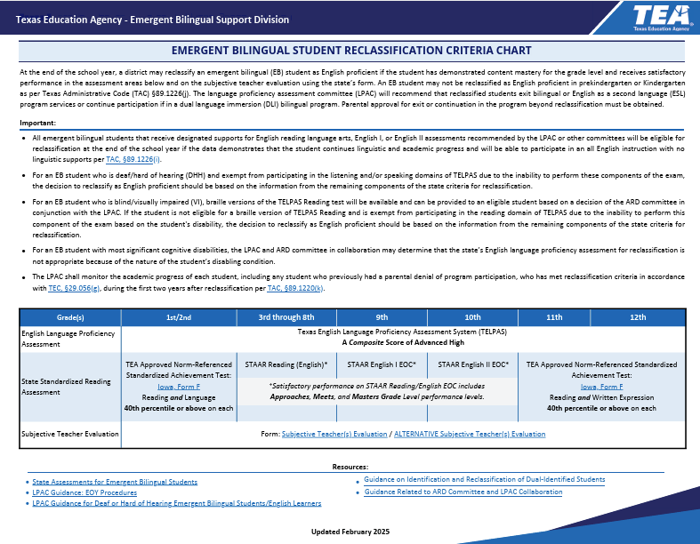
EB Student Reclassification Chart
Copyright © 2025. Texas Education Agency.
26
Notes:
Slide 24
You can find the emergent bilingual Reclassification Chart on TEAs Bilingual/ESL webpage:
https://tea.texas.gov/academics/special-student-populations/bilingual-esl-education

Slide 27
Parent or Guardian Notification
and Approval
The school district shall:
  Give written notification to the student's parent or legal guardian that his or her child has met all criteria to be reclassified as English proficient;
  Share the LPAC’s recommendation for program exit or for continued participation in program (e.g. for students in a dual language immersion program);
  Acquire written parental approval, as appropriate, for exit from the bilingual or ESL program, and as required under the Texas Education Code, §29.056(a).
  Provide bilingual education services (including bilingual programs and English as a second language programs) shall use the required, standardized letters provided by the Texas Education Agency (TEA) for each step in the process related to emergent bilingual student programming.
Copyright © 2025. Texas Education Agency.
27
Notes:
Slide 25
Emphasize that the LPAC determines student reclassification; the parents or guardians provide permission for program exit. Reclassification does not always equate with program exit. For example, for students participating in a dual language program, one-way or two-way, continued program participation after reclassification is a foundational expectation of the program model.
According to TAC 89.1220 (m), a school district may place or exit a student in a program without written approval of the student's parent if:
(1) the student is 18 years of age or has had the disabilities of minority removed;
(2) the parent provides approval through a phone conversation or e-mail that is documented in writing and retained; or
(3) an adult who the school district recognizes as standing in parental relation to the student provides written approval. This may include a foster parent or employee of a state or local governmental agency with temporary possession or control of the student.

Slide 28
Parent or Guardian Notification and Approval
Students meeting the requirements for reclassification may, at parent or guardian request, continue in the bilingual education, bilingual or ESL programs, at the district’s discretion.
Only reclassified students who continue to participate in dual language two-way programs will continue to generate bilingual education allotment funds.
Copyright © 2025. Texas Education Agency.
28
Notes:
Slide 26
Code Guide

Slide 29

LPAC - Review and Reclassification
For more information, contact: titleiii.initiatives@esc20.info
Copyright © 2025. Texas Education Agency.

