Slide 1
Review and Reclassification
FRAMEWORK
Review and Reclassification

Slide 2
Copyright © Notice
Copyright © 2020. Texas Education Agency.
All Rights Reserved.
Notwithstanding the foregoing, the right to reproduce the copyrighted work is granted to Texas public school districts, Texas charter schools, and Texas education service centers for non-profit educational use within the state of Texas, and to residents of the state of Texas for their own personal, non-profit educational use, and provided further that no charge is made for such reproduced materials other than to cover the out-of-pocket cost of reproduction and distribution. No other rights, express or implied, are granted hereby.
For more information, please contact: copyrights@tea.texas.gov
Notes:
Slide 2

Slide 3
Agenda
Introduction
Identification
Placement
English Learner Services
Review and Reclassification
Monitoring and Evaluation
Notes:
Slide 3

Slide 4
Review and Reclassification Section Objective
Content Objective
We will be able to summarize the requirements for conducting ongoing and annual review of English learner progress and criteria for reclassification of students as English proficient.
Notes:
Slide 4

Slide 5
Ongoing/Mid-Year Review
Notes:
Slide 5

Slide 6
Ongoing Monitoring of English Learners
For English learners participating in a program and those with a parental denial, the LPAC
monitors the progress of academic and language proficiency and
ensures participation in TELPAS (listening, speaking, reading, and writing) until reclassification as an English proficient student.
Notes:
Slide 6
The students’ teachers should be aware of which students have a parental denial of program services.
The LPAC should continue to communicate with the students’ parents or guardians throughout the school year, providing updates on the students’ progress.

Slide 7
State Assessments: LPAC Decision-Making
Close to the time of testing administration of the state criterion-referenced test (STAAR) each year, the language proficiency assessment committee shall
determine the appropriate assessment option for each English learner.
make designated support decisions based on
an individual student’s particular needs for second language acquisition support and
whether the student routinely, independently, and effectively uses the designated support in instruction and classroom testing.
Notes:
Slide 7
LPACs are responsible for following administrative procedures in the guide, making decisions on an individual student basis, working as a committee to make decisions, and maintaining the required documentation.
LPACs must coordinate with subject-area teachers. Providing unfamiliar accommodations may hinder rather than help a student.
Designated support decisions should be made as close as possible to the assessment to account for the student’s progress in acquiring the English language.
LPACs may not recommend designated supports, special assessment considerations, or accountability provisions for an English learner whose parents or guardians have denied bilingual or ESL services. This includes no designated supports, no testing in Spanish, no English I special provision, and no unschooled asylee or refugee provisions.
Please visit the LPAC Decision-Making Resources located at the following link:
https://tea.texas.gov/student-assessment/testing/student-assessment-overview/accommodation-resources/language-proficiency-assessment-committee-resources.

Slide 8
State Assessments LPAC Decision-Making
State Assessments: LPAC Decision-Making
For English learners who are receiving program services, the LPAC shall:
Make decisions that are applicable for all assessments administered in the current school year and may carry over decisions from spring to summer administrations.
Identify STAAR designated supports (for English learners receiving services only), keeping in mind some supports may prevent the student from being considered for reclassification at the end of the year.
Document any changes in a student's situation that have occurred between administrations, especially if a student no longer requires designated supports.
LPAC Decision-Making – Student Assessment Division
Notes:
Slide 8
Please visit the LPAC Decision-Making Resources located at the following link:
https://tea.texas.gov/student-assessment/testing/student-assessment-overview/accommodation-resources/language-proficiency-assessment-committee-resources
See the English Learner Reclassification Criteria Chart for information on designated supports that prevent reclassification, located on the TEA Bilingual/ESL Programs webpage: https://tea.texas.gov/academics/special-student-populations/bilingual-esl-education.

Slide 9
State Assessments: LPAC Decision-Making
State Assessments: LPAC Decision-Making
For English learners with parental denial of services, the LPAC shall not designate supports for STAAR assessments, including
No testing in Spanish
No English I special provisions
No unschooled asylee/refugee provisions
LPAC Decision-Making – Student Assessment Division
Notes:
Slide 9
Please visit the LPAC Decision-Making Resources located at the following link:
https://tea.texas.gov/student-assessment/testing/student-assessment-overview/accommodation-resources/language-proficiency-assessment-committee-resources

Slide 10
TELPA Participation
TELPAS Participation
Texas English Language Proficiency Assessment System (TELPAS) and TELPAS Alternate:
Fulfill federal requirements for annually assessing English language proficiency of ELs in K-12
Assess language proficiency in listening, speaking, reading and writing
For TELPAS assessments, all English learners are assessed, regardless of whether parents or guardians have denied bilingual education or ESL program services.
For ELs receiving special education services, the LPAC works in conjunction with the admission, review, and dismissal (ARD) committee.
LPAC Decision-Making – Student Assessment Division
Notes:
Slide 10
Please visit the LPAC Decision-Making Resources located at the following link:
https://tea.texas.gov/student-assessment/testing/student-assessment-overview/accommodation-resources/language-proficiency-assessment-committee-resources
LPACs are responsible for making and documenting TELPAS participation decisions.

Slide 11
Alternate English Language Proficiency (ELP) Assessment
34 CFR §200.6(h)(5) requires that a State administer an alternate ELP assessment for English learners with the most significant cognitive disabilities who cannot participate in the ELP assessment, even with appropriate accommodations.
Texas developed the TELPAS Alternate, a holistic inventory that assesses English language proficiency to
satisfy the alternate ELP assessment requirement for students with the most significant cognitive disabilities AND
reduce exemptions from specific language domains on TELPAS.
TELPAS Alternate
Notes:
Slide 11
Please visit the LPAC Decision-Making Resources located at the following link:
https://tea.texas.gov/student-assessment/testing/student-assessment-overview/accommodation-resources/language-proficiency-assessment-committee-resources

Slide 12
LPAC Decision-Making for Dual-Identified Students
19 TAC Chapter 101 of the TAC requires the LPAC to work in conjunction with the ARD Committee to make assessment decisions or English learners who are also eligible for special education services.
This collaboration helps ensure that factors related to a student’s disability and second language acquisition are both carefully considered.
LPAC Decision-Making – Student Assessment Division
Notes:
Slide 12
For more information please read the Guidance Related to ARD Committee and LPAC Collaboration located at the following link: https://tea.texas.gov/academics/special-student-populations/special-education/programs-and-services/state-guidance/guidance-related-to-ard-committee-and-lpac-collaboration

Slide 13
LPAC Decision-Making for Dual-Identified Students
The LPAC is responsible for making designated supports decisions for the STAAR program or other applicable committee. and TELPAS in conjunction with the student’s ARD, Section 504, RTI,
Designated supports decisions related to the student’s particular needs for second language acquisition support.
Designated supports decisions related to the student’s disability.
These committees should become familiar with all information on the TEA Accommodation Resources webpage.
LPAC Decision-Making – Student Assessment Division
Notes:
Slide 13
For more information please visit the Accommodation Resources webpage:
https://tea.texas.gov/student-assessment/testing/student-assessment-overview/accommodation-resources

Slide 14
Accessibility Resources
Designated supports decisions for STAAR and TELPAS are to be made by LPACs in accordance with policies and procedures in the following:
Decision-Making Guide for LPACs
https://tea.texas.gov/student.assessment/ell/lpac/
Accessibility Policy Documents located on TEA’s Accommodation Resources webpage
https://tea.texas.gov/accommodations/
LPAC Decision-Making – Student Assessment Division
Notes:
Slide 14

Slide 15
LPAC Annual Review
At the end of the year, the LPAC reviews every English learner identified in PEIMS
being served in a bilingual or ESL program;
with a parental denial; and
who has been reclassified as an English proficient student and is in his or her first (F) or second (S) year of monitoring.
For each English learner, the LPAC reviews the progress of academic and language proficiency, determines if reclassification criteria has been met, and notifies the parent or guardian of progress and reclassification/exit, as applicable.
Notes:
Slide 15
The LPAC end-of-year review may include:
Benchmarks
Classroom Tests
State Criterion-Referenced Test Data
Norm-referenced English and Spanish (when applicable) Standardized Achievement Test Data
Oral Language/English Language Proficiency Test Data
TELPAS, Primary Reading Assessments, etc.
Passing grades in all subjects and courses taken
Any input that will give a well-rounded picture of the student’s growth and progress

Slide 16
Reclassification of English Learners
For exit from a bilingual education or ESL program, a student may be classified as English proficient only at the end of the school year in which a student would be able to participate equally in a general education, all-English instructional program. This determination shall be based upon all of the following:
a proficiency rating on the state-approved English language proficiency test for reclassification that is designated for indicating English proficiency in each the four language domains (listening, speaking, reading, and writing);
passing standard met on the reading assessment instrument under the Texas Education Code (TEC), §39.023(a), or, for students at grade levels not assessed by the aforementioned reading assessment instrument, a score at or above the 40th percentile on both the English reading and the English language arts sections of the state-approved norm-referenced standardized achievement instrument; and
the results of a subjective teacher evaluation using the state's standardized rubric.
Notes:
Slide 16

Slide 17
English Learner Reclassification Rubric
Subjective Teacher Evaluation
To meet ESSA Title III, Part A requirements as described in the Texas ESSA State Plan for a standardized, statewide exit criteria, the English learner Reclassification Rubric is utilized for the Subjective Teacher Evaluation portion of the reclassification criteria.
The English Learner Reclassification Rubric-Alternate is utilized for English learners with a significant cognitive disability to fulfill the Subjective Teacher Evaluation portion of the individualized reclassification criteria.
Notes:
Slide 17
See the English Learner Reclassification Rubric and English Learner Reclassification Rubric – Alternate on the TEA Bilingual/ESL Programs webpage: https://tea.texas.gov/academics/special-student-populations/bilingual-esl-education.
These rubrics are NOT suggested forms. They are required forms that must be used without modification and must be retained in the student’s records.

Slide 18
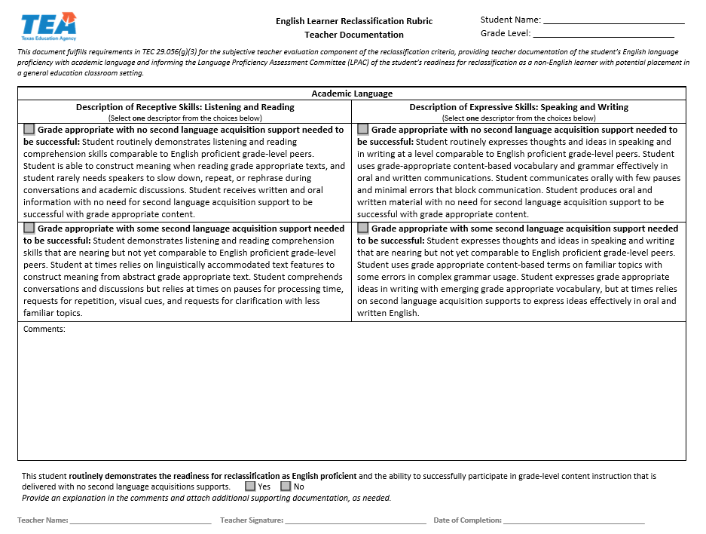
English Learner Reclassification Rubric
Notes:
Slide 18
This is NOT a suggested form. This is a required form that must be used, and not modified, and must be retained in the student’s records.

Slide 19
English Learner Reclassification Rubric- ALTERNATE
Notes:
Slide 19

Slide 20
Decisions Pending Results
If STAAR results are not yet available when the LPAC meets at the end of the school year to make reclassification decisions, the LPAC will conduct the following process:
The LPAC makes the decision for reclassification, pending STAAR results, if the student has met all other reclassification criteria and if the LPAC determines that the student will be ready for reclassification if STAAR results demonstrate that the student has met standard (Approaches, Meets, or Masters levels).
The LPAC must have a follow-up process as soon as scores are received by the district to enact on the LPAC reclassification decisions pending STAAR results.
Once scores are received, a member of the LPAC will enter the scores into the LPAC documentation and complete the reclassification process for eligible students without the need for another LPAC meeting.
Notes:
Slide 20
The school district shall give written notification to the student's parent or guardian of the student's reclassification as English proficient and his or her exit from the bilingual education or ESL program and acquire written approval as required under the Texas Education Code, §29.056(a).

Slide 21
Reclassification of English Learners
A student in prekindergarten or kindergarten may not be reclassified as an English learner; the first opportunity for an English learner to be considered for reclassification is in grade one.
A school district must ensure that English learners are prepared to meet academic standards required by the TEC, §28.0211.
Notes:
Slide 21

Slide 22
Reclassification of Dual-Identified Students
For English learners who are also eligible for special education services, the district assures that:
decisions regarding reclassification as English proficient are made by the LPAC in conjunction with the ARD committee, implementing assessment procedures that differentiate between language proficiency and disabling conditions; and
the standardized process for English learner reclassification is followed, EXCEPT in cases where the student has a significant cognitive disability and the individualized process for reclassification is used.
Notes:
Slide 22
For more information please read the Guidance Related to ARD Committee and LPAC Collaboration located at the following link: https://tea.texas.gov/academics/special-student-populations/special-education/programs-and-services/state-guidance/guidance-related-to-ard-committee-and-lpac-collaboration.

Slide 23
Reclassification of English Learners with Significant Cognitive Disabilities
For English learners with significant cognitive disabilities, the LPAC in conjunction with the ARD committee shall meet and may:
determine that the state's English language proficiency assessment for reclassification is not appropriate because of the nature of the student's disabling condition;
may recommend that the student take the state's alternate English language proficiency assessment (TELPAS Alt) and shall determine an appropriate performance standard requirement for reclassification by language domain.
Notes:
Slide 23
Please review the Steps to the Individualized Reclassification Process for a Student with a Significant Cognitive Disability: Section 3
https://tea.texas.gov/sites/default/files/LPAC%20ARD%20Collaboration%20Guidance%20and%20Process%20for%20Reclassification.pdf

Slide 24
English Learner Reclassification Chart
2020–2021 English Learner Reclassification Criteria Chart
At the end of the school year, a district may reclassify an English Learner (EL) as English proficient for the first time or a subsequent time if the student is able to participate equally in a regular all-English instruction program as determined by satisfactory performance in the following assessment options areas below and the results of a subjective teacher evaluation. An English learner may not be reclassified as English proficient in prekindergarten or kindergarten as per Texas Administrative Code §89.1226(j).
 | 1st | 2nd | 3rd | 4th | 5th | 6th | 7th | 8th | 9th | 10th | 11th/12th
English Language Proficiency Assessment | Texas English Language Proficiency Assessment System (TELPAS) Advanced High in each domain of Listening, Speaking, Reading and Writing
State Standardized Reading Assessment | TEA Approved Norm-Referenced Standardized Achievement Test (Reading/Language) 40th percentile or above |  | STAAR Reading (English) |  |  |  |  |  | STAAR English I EOC | STAAR English II EOC | TEA Approved Norm-Referenced Standardized Achievement Test (Reading/Language) 40th percentile or above
Subjective Teacher Evaluation | Form: English Learner Reclassification Rubric
Note: The LPAC shall monitor the academic progress of each student who has met reclassification criteria during the first two years after reclassification. Note: English learners with significant cognitive disabilities who are receiving special education services may qualify to be reclassified using the following: Individualized Reclassification Process for a Student with a Significant Cognitive Disability. For information on the TEA Approved Norm-Reference Standardized Achievement Test, please visit the following webpage: https://www.riverside-assessments.com/texas-assessment. For information on State Assessments for English Learners, please visit the following webpage: https://tea.texas.gov/student-assessment/testing/student-assessment-overview/accommodation-resources/information-on-state-assessments-for-english-learners.
Notes:
Slide 24
You can find the English Learner Reclassification Chart on TEAs Bilingual/ESL webpage:
https://tea.texas.gov/academics/special-student-populations/bilingual-esl-education

Slide 25
Parent or Guardian Notification and Approval
The school district shall:
Give written notification to the student's parent or legal guardian that his or her child has met all criteria to be reclassified as English proficient;
Share the LPAC’s recommendation for program exit or for continued participation in program (e.g. for students in a dual language immersion program);
Acquire written parental approval, as appropriate, for exit from the bilingual education or ESL program, and as required under the Texas Education Code, §29.056(a).
Notes:
Slide 25
Emphasize that the LPAC determines student reclassification; the parents or guardians provide permission for program exit. Reclassification does not always equate with program exit. For example, for students participating in a dual language program, one-way or two-way, continued program participation after reclassification is a foundational expectation of the program model.
According to TAC 89.1220 (m), a school district may place or exit a student in a program without written approval of the student's parent if:
(1) the student is 18 years of age or has had the disabilities of minority removed;
(2) the parent provides approval through a phone conversation or e-mail that is documented in writing and retained; or
(3) an adult who the school district recognizes as standing in parental relation to the student provides written approval. This may include a foster parent or employee of a state or local governmental agency with temporary possession or control of the student.

Slide 26
Parent or Guardian Notification and Approval
Students meeting the requirements for reclassification may, at parent or guardian request, continue in the bilingual education or ESL program, at the district’s discretion.
Only reclassified students who continue to participate in dual language two-way programs will continue to generate bilingual education allotment funds.
Notes:
Slide 26

