Slide 1



Placement
Copyright © 2025. Texas Education Agency.

Slide 2
Copyright © Notice
Copyright © 2025. Texas Education Agency.
All Rights Reserved.
Notwithstanding the foregoing, the right to reproduce the copyrighted work is granted to Texas public school districts, Texas charter schools, and Texas education service centers for non-profit educational use within the state of Texas, and to residents of the state of Texas for their own personal, non-profit educational use, and provided further that no charge is made for such reproduced materials other than to cover the out-of-pocket cost of reproduction and distribution. No other rights, express or implied, are granted hereby.
For more information, please contact: copyrights@tea.texas.gov
Copyright © 2025. Texas Education Agency.
Notes:
Slide 2

Slide 3
Training Agenda
Introduction
Identification
Placement 89 TAC §1220 (2025)
Emergent Bilingual Services
Review and Reclassification
Monitoring and Evaluation
Copyright © 2025. Texas Education Agency.
Notes:
Slide 3

Slide 4
Placement Section Objective
Content/Language Objective
We will be able to explain the rights of parents and guardians regarding the process of placement, benefits of program services, and approval for program participation.
Copyright © 2025. Texas Education Agency.
Notes:
Slide 4

Slide 5
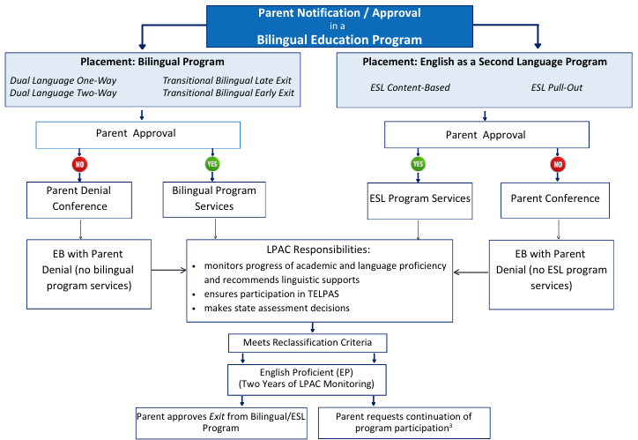
Parent or Guardian Approval
Copyright © 2025. Texas Education Agency.
Notes:
Slide 5

Slide 6
Parent or Guardian Rights and
Responsibilities: Notification
The parent or legal guardian shall be notified in their home language and English of the following:
  Their child’s classification as an emergent bilingual student.
  The recommendation for placement of their child in the required bilingual English as a second language (ESL) program.
  The purpose, content, and benefits to the student of the recommended bilingual/ESL program.
  The fact that the recommended bilingual/ESL program is an integral part of the general school program.
Copyright © 2025. Texas Education Agency.
Notes:
Slide 6
The letter the district sends to obtain parent or guardian approval for placement in the program must contain the following:
Level of English proficiency
Description of the program
Benefits of the program
It is also important to explain why the program recommendation is offered, and what the parent or guardian can expect of instruction and other services, as per the Elementary and Secondary Education Act of 1965 Public Law 115-141, as amended by the Every Student Succeeds Act (ESSA), section 1112 (2015).
A plan for when the student may graduate and be reclassified, according to the Personal Graduation Plan (PGP) for emergent bilinguals at high school, may be included along with the benefits of the program.
Parent bilingual and ESL program benefits brochures are available in English, Spanish and Vietnamese at https://www.txel.org/parents-and-families/.

Slide 7
Parent or Guardian Rights and
Responsibilities: Notification
The parent or legal guardian shall:
  Receive written notice of the student's classification as an emergent bilingual student and the LPAC request for approval of placement of their child in the recommended bilingual or ESL program not later than the 10th calendar day after the date of the student's classification.
  Provide written approval or denial of placement of their child in the recommended program services.
Copyright © 2025. Texas Education Agency.
Notes:
Slide 7

Slide 8
Parent or Guardian Approval
Parental approval shall be considered valid for the student's continued participation in the required bilingual or ESL program until
  the student meets the reclassification criteria described in §89.1226(i) of this title (relating to Testing and Classification of Students), or
  the student graduates from high school, or
  a change occurs in program placement.
Pending parental approval of an emergent bilingual students entry into services, the school district shall place the student in the recommended program.
Copyright © 2025. Texas Education Agency.
Notes:
Slide 8
For information on PEIMS codes, please review the following resources on the TEA Bilingual/ESL webpage (https://tea.texas.gov/academics/special-student-populations/bilingual-esl-education) under Program Requirement Resources:
English proficient/EB Decision Chart for LPAC with PEIMS codes
Code Guide for Bilingual and ESL Program Association
Texas Education Data Standards (TEDS) Section 4 – Description of codes related to emergent bilingual students

Slide 9
Program Placement, Without
Written Approval
A school district may place in or exit a student from a program without written approval of the student’s parent or guardian if:
the student is 18 years of age or has had the disabilities of minority removed;
the parent or legal guardian provides approval through a phone conversation or e-mail that is documented in writing and retained; or
an adult who the school district recognizes as standing in parental relation to the student provides written approval. This may include a foster parent or employee of a state or local governmental agency with temporary possession or control of the student.
§89.1240
Copyright © 2025. Texas Education Agency.
Notes:
Slide 9
The LEA must ensure the verbal or email approval is obtained from a verified source.
For students for whom written approval is not immediately obtained, districts should use caution when temporarily coding a student in PEIMS with a 7 – Parent or Guardian did not respond. Without continuous follow up to ensure parental approval has been obtained, a student’s access to program services may be affected, and the district would not generate bilingual education allotment (BEA) funding for that student.

Slide 10
Parent or Guardian Denial
In cases where a parent or guardian denies placement in bilingual education, including bilingual or ESL services, the student:
  Is identified in PEIMS as an emergent bilingual student with a parental denial and remains classified as an emergent bilingual student until the student meets reclassification criteria.
  Participates in the annual TELPAS assessment and receives linguistic support during instruction until the student meets reclassification criteria.
It is the responsibility of the LPAC to monitor the linguistic and academic progress of all emergent bilingual students, including those whose parents have denied program services.
Copyright © 2025. Texas Education Agency.
Notes:
Slide 10
Review the following information about a student whose parent or guardian denied services.
The student is an emergent bilingual student and is coded as English Proficient/EB in PEIMS.
The LPAC should inform teachers which students are parent or guardian denials.
Teachers should be provided TELPAS information on each student, if available, and implement the ELPS in the classroom.
The student will be assessed through TELPAS.
The LPAC must annually review the progress of the student.

Slide 11
Dually Identified Students
When recommending program services for an emergent bilingual student who is also served through special education, the LPAC in conjunction with the ARD committee shall:
establish placement procedures that ensure that placement in a bilingual or ESL program is not refused solely because a student has a disability.
facilitate student participation in other special programs (Advanced Academics/Gifted and Talented, Special Education, Career and Technical Education, Dyslexia, etc.) while ensuring full access to the language program services.
Copyright © 2025. Texas Education Agency.
Notes:
Slide 11

Slide 12

LPAC - Placement
For more information, contact: titleiii.initiatives@esc20.info
Copyright © 2025. Texas Education Agency.
Notes:
Slide 12

