Slide 1
Dual Language Immersion
HQIM Implementation Resources Using Amplify (CER Version 4)
Notes:
Good afternoon,
This video will walk you through the DUAL LANGUAGE IMMERSION HQIM IMPLEMENTATION RESOURCES USING AMPLIFY (CER VERSION 4). For the purpose of this video, we will only review the kindergarten resources, but please know that all resources discussed in this video can be found in first grade and second grade as well.

Slide 2

Notes:
When you first open the guide, you will see the cover page followed by the the table of contents.

Slide 3
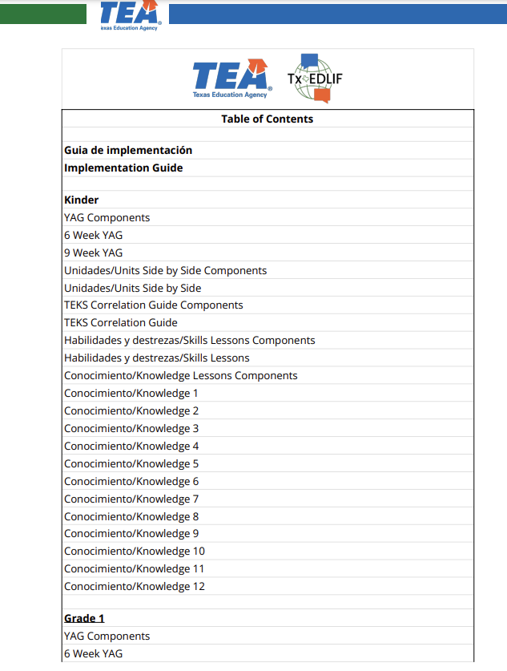
Notes:
The table of contents is organized by grade level, starting with kindergarten then proceeding to first grade

Slide 4
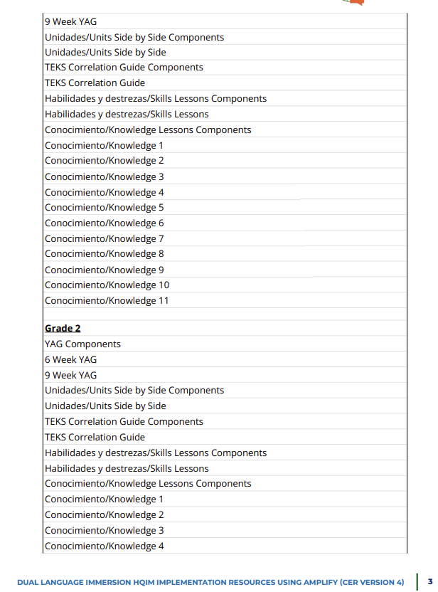
Notes:
And finally second grade

Slide 5
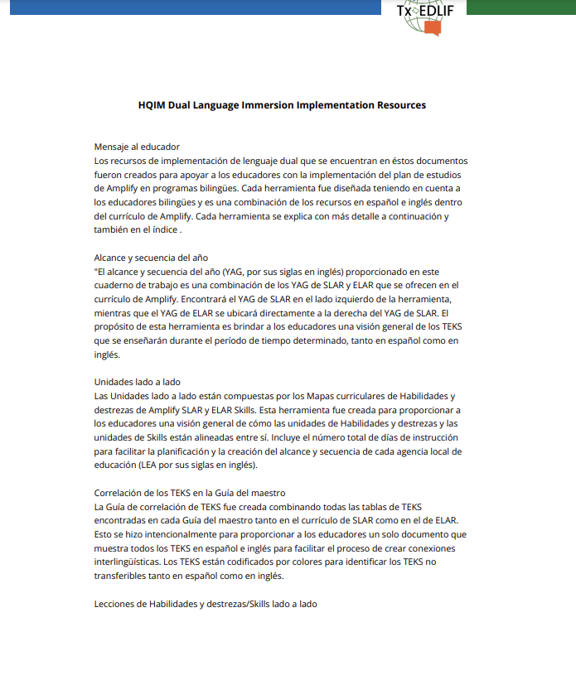
Notes:
The first resource you will find is the implementation guide in Spanish

Slide 6
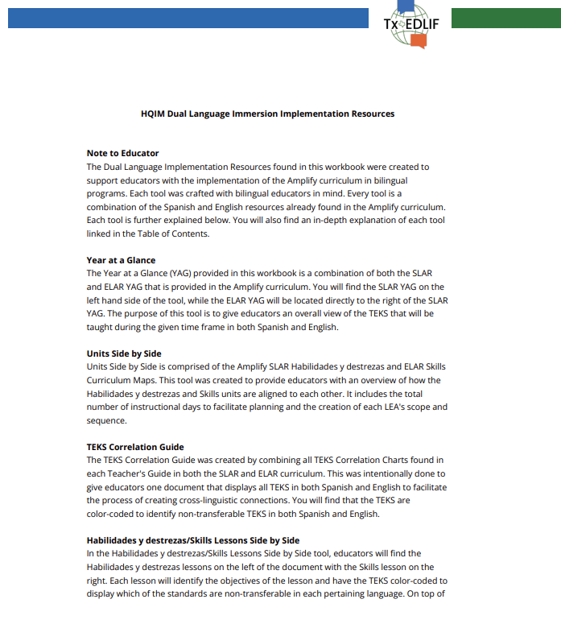
Notes:
followed by the implementation guide in English.This document will provide educators with an overview of each resource included in this guide which are the year at a glance, for both 6 and 9 weeks, a document that shows the units side by side for skills and habilidades y destrezas., the TEKS correlation guide, the habilidades y destrezas skills lessons side by side,

Slide 7
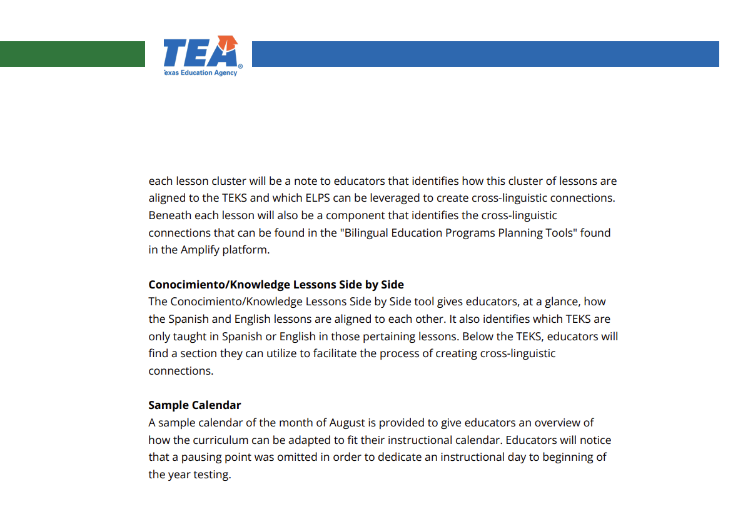
Notes:
the conocimiento and knowledge lessons side by side and a sample calendar. Each of these tools will be discussed in detail throughout this video.

Slide 8
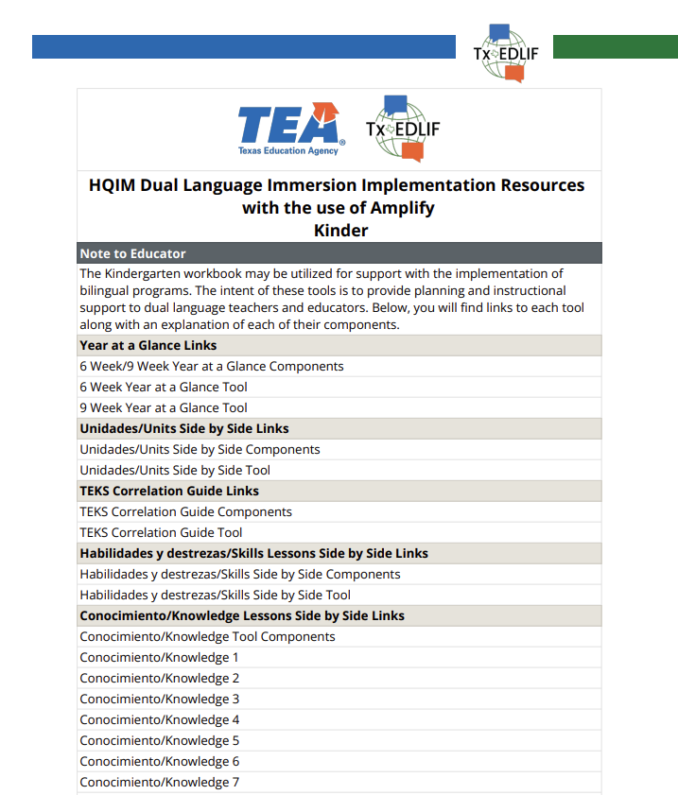
Notes:
After the implementation guide, you will find the Kinder HQIM Dual Language Implementation Resources. All kindergarten resources are hyperlinked on page 9, first grade resources are linked on page 234 and all second grade resources are linked on page 445. As mentioned earlier, we will only review the kindergarten resources, but all resources discussed can be found in first and second grade as well.

Slide 9
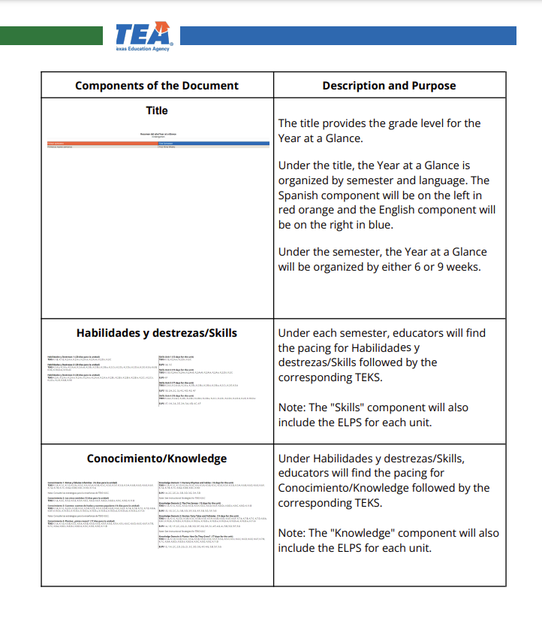
Notes:
Each tool will be accompanied by a one pager which will describe each tool’s components in detail such as the one seen here.

Slide 10
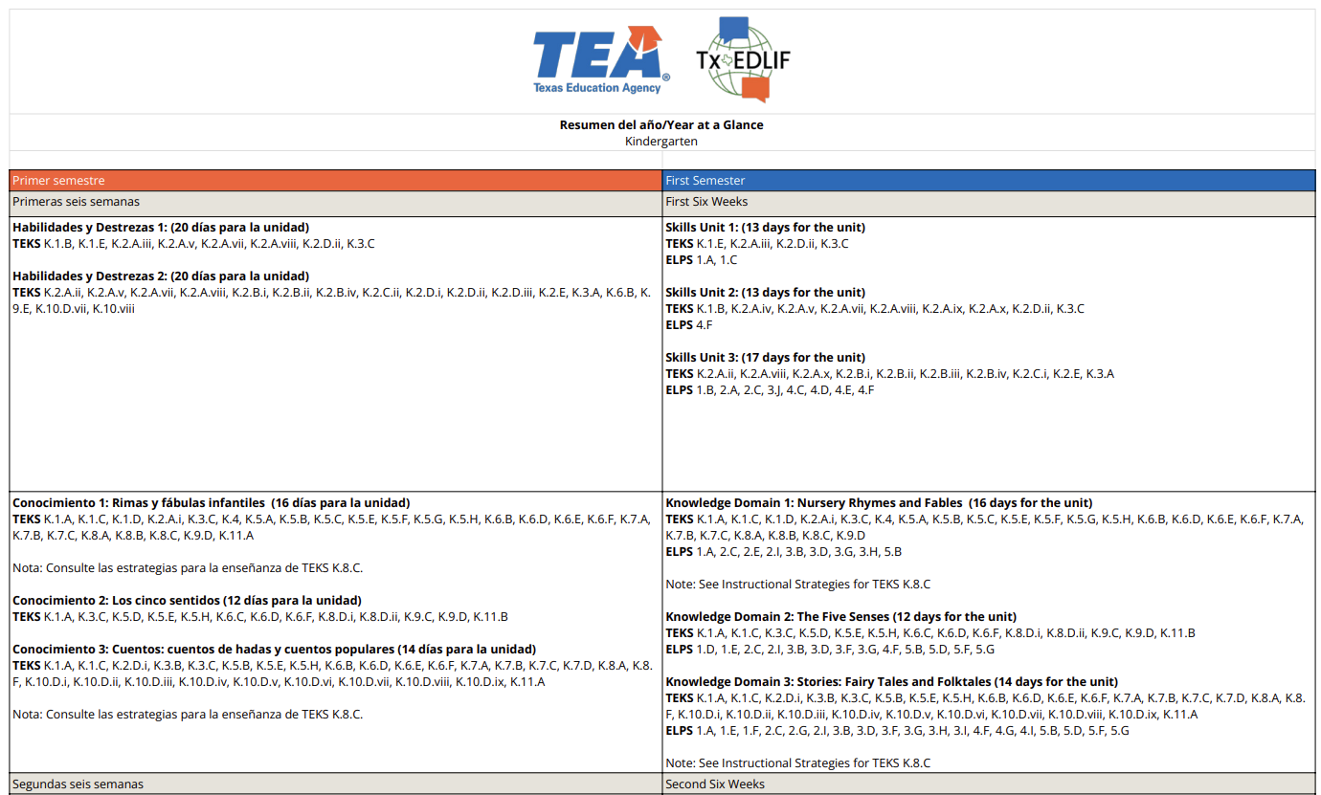
Notes:
The first resource you will find is the year at a glance.Educators will notice that all documents are organized by having the Spanish component on the left and the English component on the right of each tool. Due to the format of these tools, you may find it helpful to zoom in to 200% when viewing the PDF. This document shows the 6 week year at a glance. Beneath each six weeks, you will see the Habilidades y destrezas and skills units and TEKS followed by the conocimiento and knowledge units and TEKS. For example, you can see that during the first six weeks of instruction, the units taught in Spanish will be habilidades y destrezas 1 y habilidades y destrezas 2, and Conocimiento 1 y conocimiento 2 while the units taught in English will be Skills units 1, 2, and 3 and for Knowledge, Domains 1, 2, and 3. This pattern continues for the entirety of the document.

Slide 11
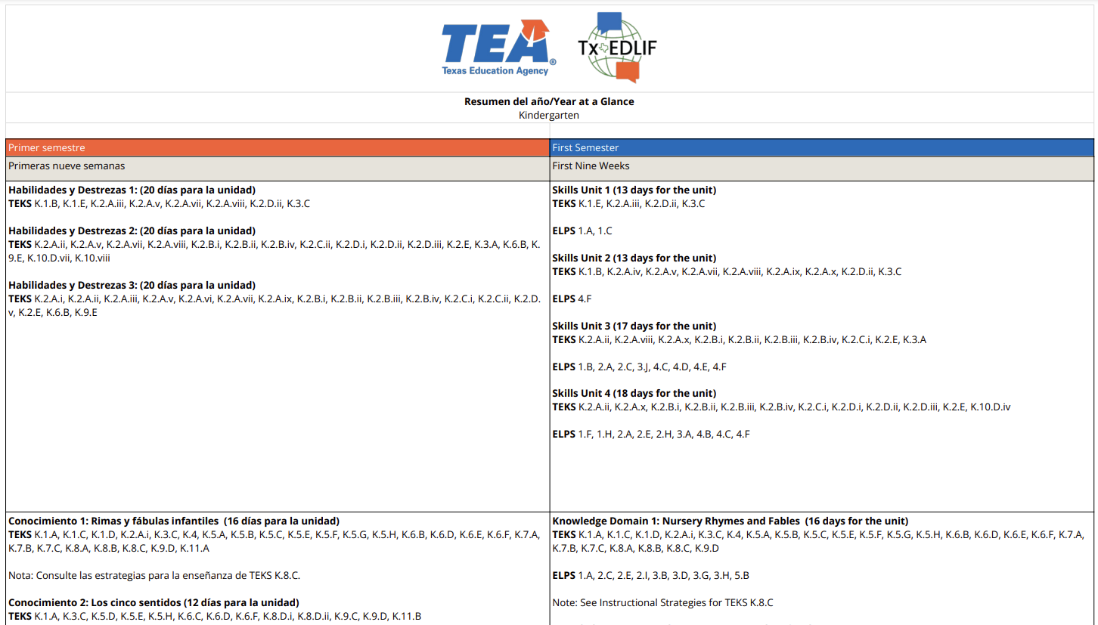
Notes:
The document that follows is the 9 week year at a glance which follows the same format. One thing to note is that the ELPS are also included in both the 6 and 9 week year at a glance.

Slide 12
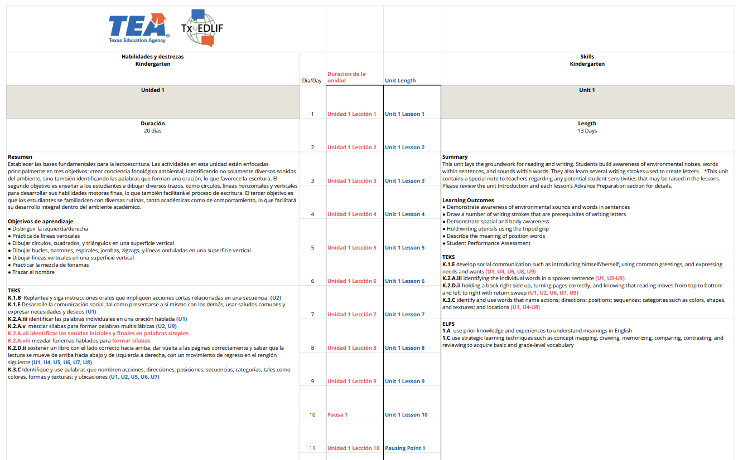
Notes:
The next resource we will view is the units side by side tool will allow educators to see the habilidades y destrezas and skills unit side by side. This document will provide the length of each unit along with the summary, learning outcomes, TEKS and ELPS. The center of the document will identify which lesson is taught during each instructional day.

Slide 13
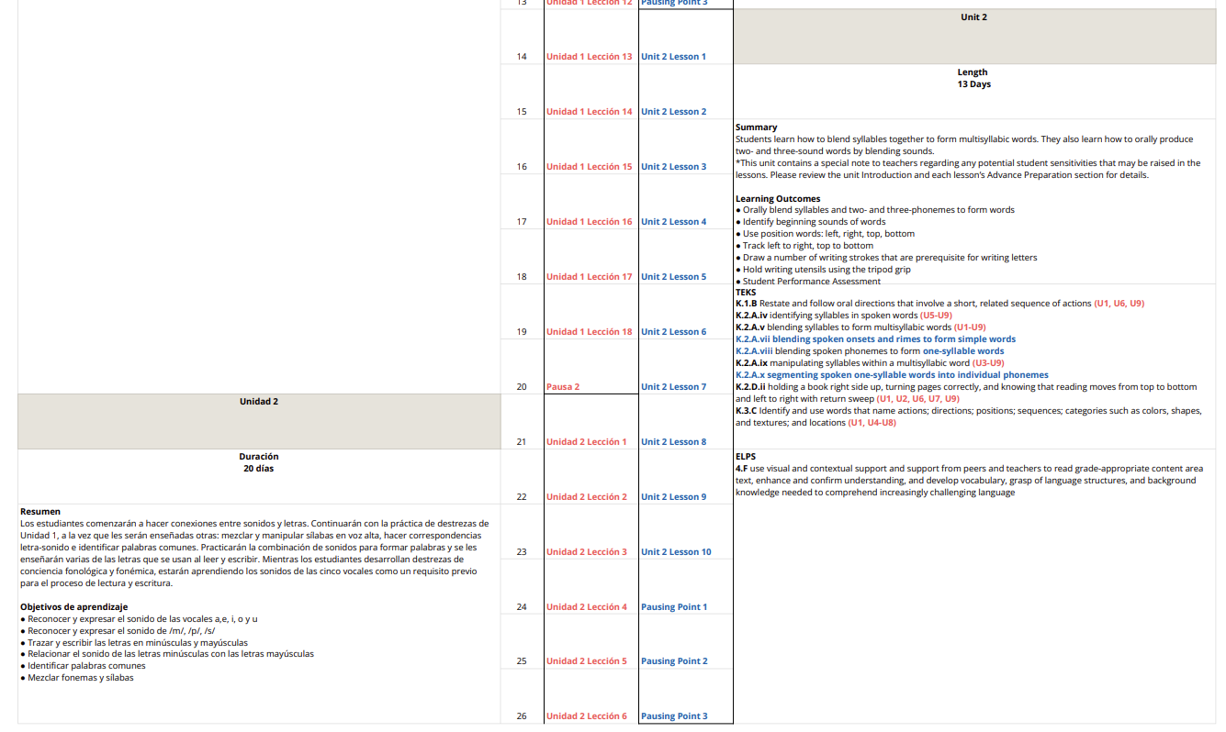
Notes:
This becomes even more helpful when the Spanish and English lessons do not align with each other such as on instructional day 14 where educators may be teaching Unidad 1 leccion 13 while in English the lesson taught is Unit 2 lesson 1.Educators will also notice that the TEKS have been color-coded to identify which TEKS are non-transferable. The non-transferable TEKS will be color-coded in blue for English and in red-orange for Spanish. At the end of the TEKS, you will also notice unit numbers. These numbers signify in which units those TEKS will be taught. For example, K.1 b can be found in units 1, 6, and 9. The TEKS Correlation Guide, which we will view shortly will pinpoint which unit and pages each TEKS can be found.

Slide 14
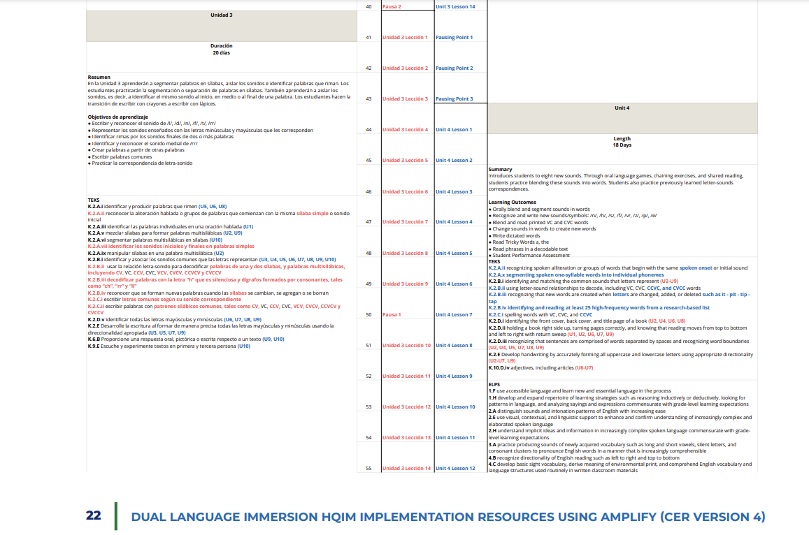
Notes:
You will see the same format for Spanish TEKS as seen here where Teks K.2 E can be found in units 3, 5, 7, and 9.

Slide 15
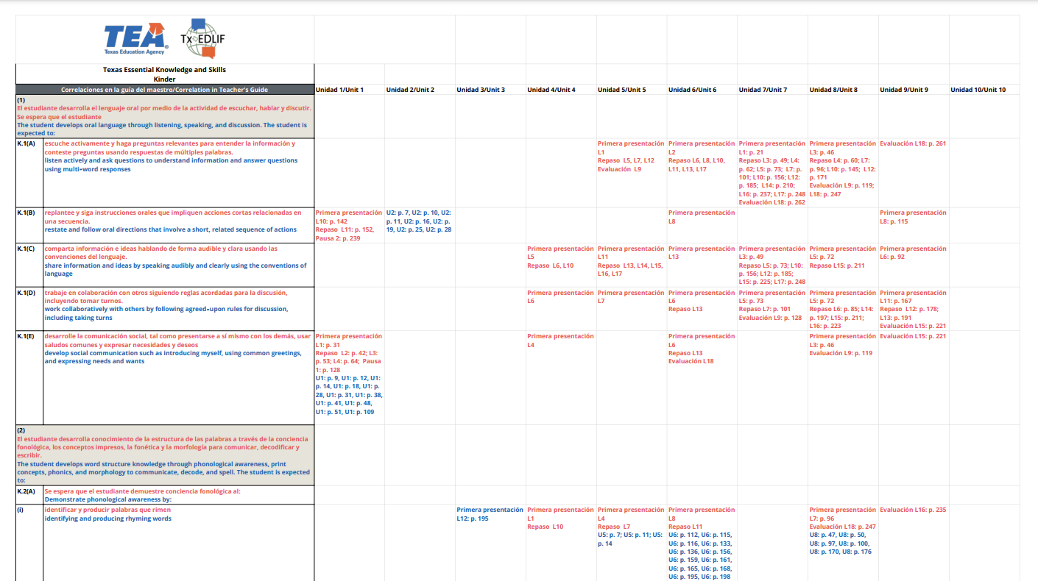
Notes:
The next document we will view is the TEKS correlation guide. This guide will identify exactly which unit and page number each TEKS can be found. Spanish will be in red-orange and English will be in blueFor example TEKS K.1 b can be found in habilidades y destrezas unides 1, 6, and 9 while this same TEKS can be found in Skills unit 2. This format will be followed for all TEKS.

Slide 16
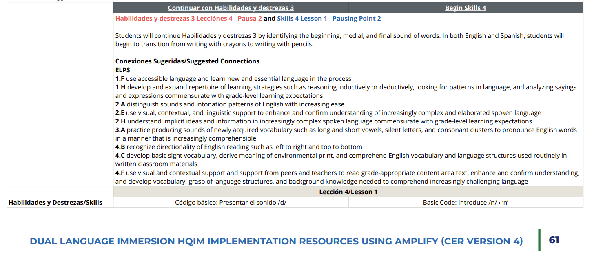
Notes:
We will now review the habilidades y destrezas and skills lessons side by side tool. The dark gray bar will not only have the unit number, but the corresponding teacher’s guide will be hyperlinked as well. Please make sure you are signed into Amplify before clicking on the link. If you are not signed in, the teacher’s guide may not load correctly. To view all components available in this document, we will view page 61. Here you will find habilidades y destrezas 3, leccion 4 next to Skills 4 Lesson 1. The first component will be the name of the lesson. In this case we have leccion 4 from habilidades y destrezas 3 titled “Codigo basico: Presentar el sonido /d/” and Lesson 1 from skills unit 4 “Basic code: Introduce /n/”.

Slide 17
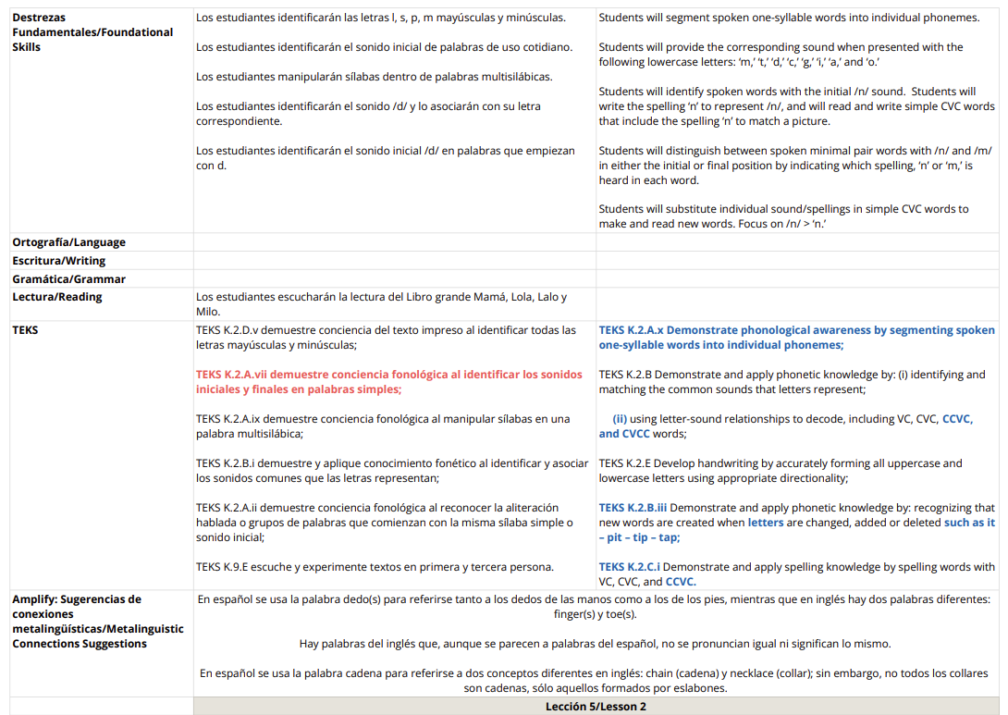
Notes:
It is then followed by the Destrezas fundamentales or foundational skills that will be taught in this lesson. If it applies, the objectives for the rest of the components will be identified. As can be seen in this example, there are no objectives for ortografia, escritura or gramatica in Spanish nor English, but there is an objective for lectura. Following the objectives will be the TEKS. The non-transferable TEKS will be color coded in red-orange for Spanish TEKS and blue for English TEKS. Underneatht the TEKS you will find the suggested metalinguistic connections. Please note that all of these components can be found in the Amplify curriculum.

Slide 18
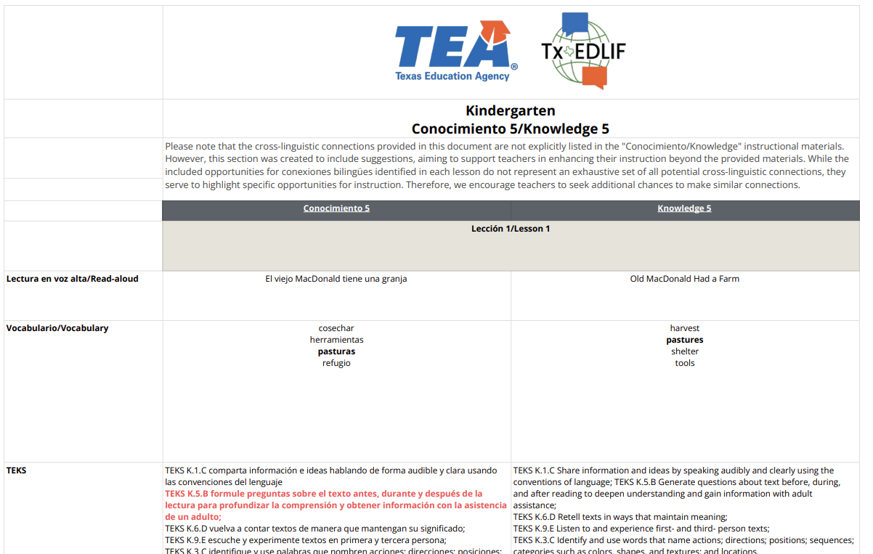
Notes:
The next document we will view is the conocimiento and knowledge lessons side by side tool. We will only view knowledge 5 but please note that all conocimiento and knowledge units are available in this resource. You will notice that the conocimiento and knowledge teacher’s guides will be linked in the dark gray bar as well. As mentioned earlier, please ensure that you are signed in to Amplify before clicking on the link. Here you can see leccion 1 and lesson 1 of knowledge unit 5 side by side. This tool will include the lesson name, vocabulary words, TEKS, and suggested metalinguistic connections. The bolded vocabulary words will signify that these words are cognates. The TEKS will be color coded when TEKS are only found in one of the paired lessons. For example TEKS K.5 B is only identified in leccion 1 but not in lesson 1 in English, so this would be important to note when planning for bilingual lessons.

Slide 19
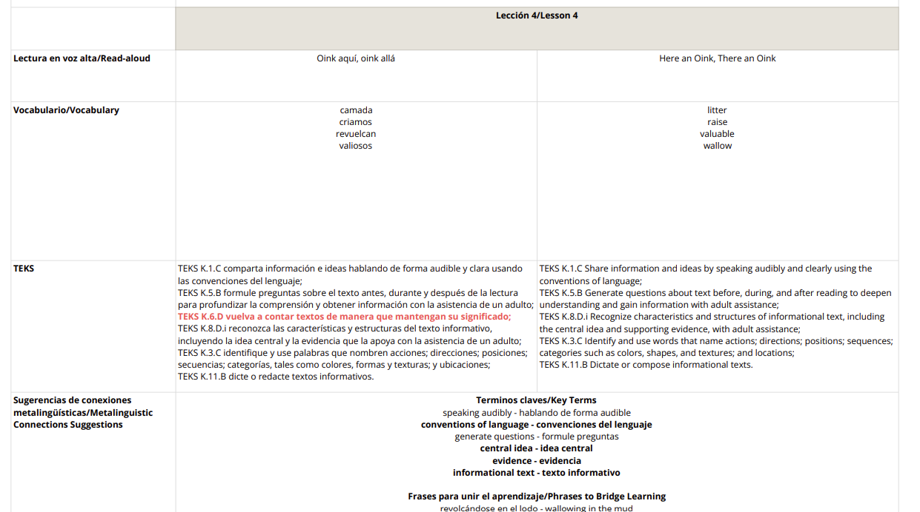
Notes:
Underneath the TEKS, you will find the sugerencias de conexiones metalinguisticas or metalinguistic connections suggestions. The bolded terms in this section will also signify to educators that these terms are cognates.

Slide 20
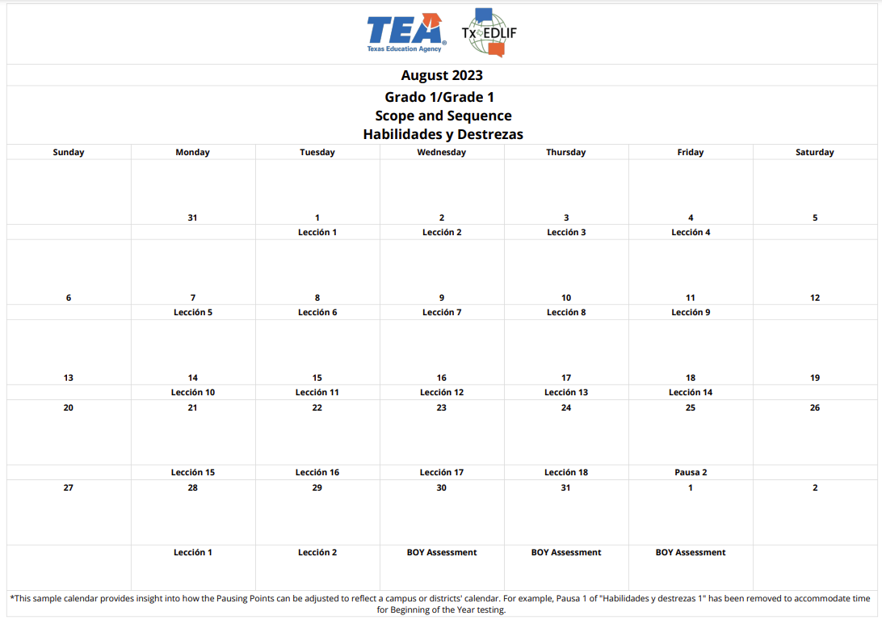
Notes:
The last document found in this guide is the sample calendar. This calendar will give an example of how educators can pace their lessons throughout the school year. For example, you will notice that Pausa 1 has been skipped after leccion 9 in this unit to accommodate for Beginning of year assessments. It is important to teach all content in Amplify, but it is understood that assessments must take place to identify areas of success and areas of growth for students.

Slide 21
Dual Language Immersion
HQIM Implementation Resources Using Amplify (CER Version 4)
Notes:
As mentioned, all of the tools discussed in this video can be found for kindergarten, first and second grade by going to page 9 for kinder, page 234 for first grade and page 445 for second grade.
Thank you for viewing this video where we discussed all components of the DUAL LANGUAGE IMMERSION HQIM IMPLEMENTATION RESOURCES USING AMPLIFY (CER VERSION 4).

